Slide 1

LatentGuard: Adaptive Dual-Layer Web Application Firewall (WAF)
Final Year Project (FYP‑I) — Bachelor of Science in Cyber Security
COMSATS University Islamabad — 2024–2025
Syed Shaheer Khalid (CIIT/SP23‑BCT‑048/ISB)
Javaria Maqbool (CIIT/SP23‑BCT‑023/ISB)
Supervisor: Dr. Farhana Jabeen

Slide 2



System Introduction
LatentGuard is an AI‑augmented Web Application Firewall placed between the internet and web applications to inspect every HTTP/HTTPS request. Designed for security engineers, DevOps teams, and enterprise security evaluators, it combines deterministic rule‑based detection with unsupervised ML to detect known and zero‑day web attacks.
Rule-based (M3)
Anomaly Detection (M4)
Clustering (M5)
ModSecurity + OWASP CRS for signature detection and immediate blocking of HIGH/CRITICAL matches.
HDBSCAN validates anomalies by finding density‑based outliers in latent space.
Autoencoder reconstructs 7‑feature vectors; high reconstruction error flags anomalies.
Consensus weighting: M4 40% • M5 30% • ModSecurity 30% → Block/Allow/Challenge decisions. Closed‑loop learning produces candidate rules for human review.

Slide 3
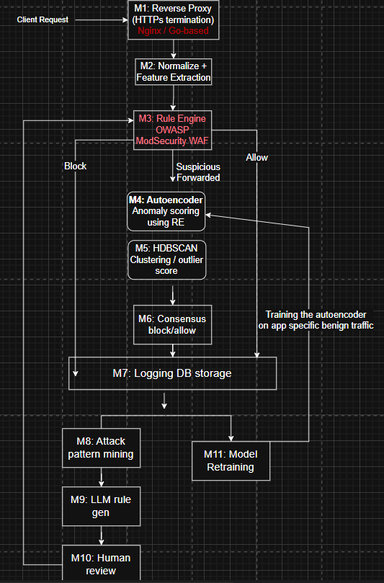
System Modules (Overview)
Ten modules (M1–M10) cover ingress, normalization, detection, consensus, logging and continuous learning. Each module is independently deployable and communicates over well‑defined APIs.
Ten modules (M1–M10) cover ingress, normalization, detection, consensus, logging and continuous learning. Each module is independently deployable and communicates over well‑defined APIs. Three main parts:
Traffic Interception, Normalization and Rule-based filtering (M1 – M2 – M3)
Autoencoder + HDBSCAN clustering analyzes nature of request using Reconstruction Error and representing it in a latent space. Following a consensus that decides what to do with the request
Logging + AI rule generation.

Slide 4
System Modules (Overview)
Ten modules (M1–M10) cover ingress, normalization, detection, consensus, logging and continuous learning. Each module is independently deployable and communicates over well‑defined APIs.
M1 — Reverse Proxy (Nginx)
M2 — Normalization & Feature Extraction
M3 — Rule Engine (ModSecurity + CRS)
M4 — Autoencoder
Reconstruction error yields anomaly score (0–1).
TLS termination, ingress filtering, request routing.
Parses/decodes requests and emits a 7‑float ML feature vector.
Signature matches produce immediate BLOCK decisions for high severity.
M5 — HDBSCAN
M6 — Consensus Engine
M7 — MongoDB Logger
M8 — Pattern Miner
Latent clustering to confirm outliers and reduce false positives.
Persistent audit trail for every request and model training data.
FP‑Growth on blocked requests to find repeating attack patterns.
Weighted aggregation of scores → final verdict, with configurable thresholds.
M9 — LLM Rule Generator
M10 — Admin Dashboard
LLM drafts ModSecurity rules from mined patterns; admin approval required.
React UI: real‑time monitoring, rule review, and deployment controls.

Slide 5
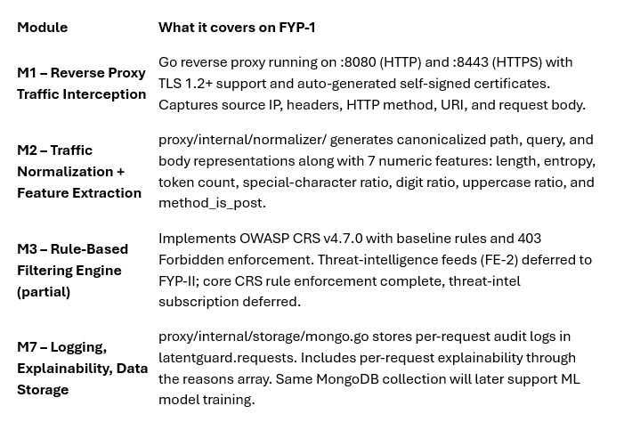
Modules We are Covering in FYP 1

Slide 6
Design Methodology
Procedural Design selected to show how data moves through the system, including requests, features, anomaly scores, and generated rules.
In LatentGuard, you'll see a layered architecture — sometimes known as a pipeline. A request enters at one end, passes through stages in order, and exits the other end with a decision attached.
Purpose of choosing a procedural design methodology:
Sequential.
Separation Of concerns: Each Layer handles a designated task.
Independent Scaling: If traffic surges, the relevant layer can scale independently
Fault tolerance: If AI layer crashes, system chooses rules layer as the fall back.
Testability: Each layer can be tested individually in unit and integration tests.

Slide 7
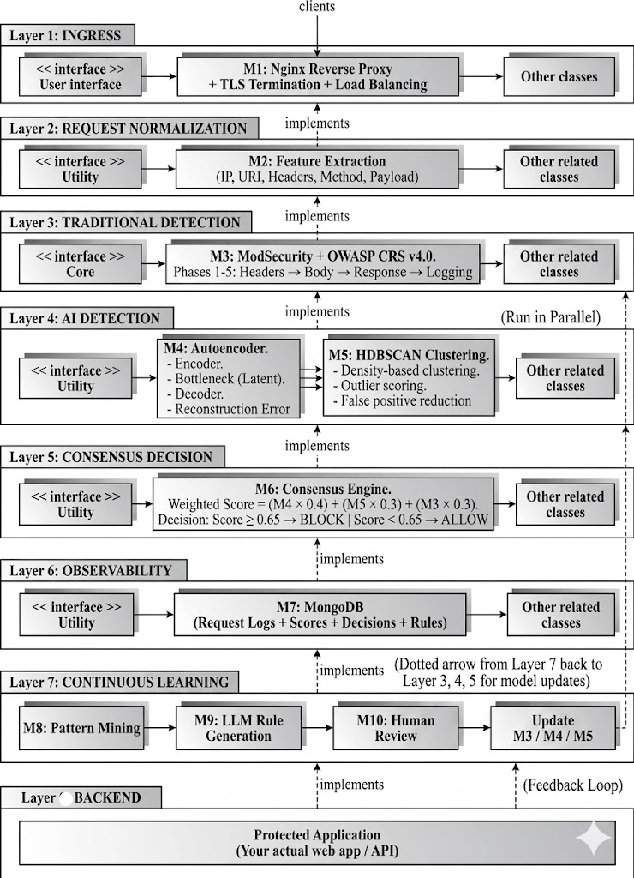
Architecture — Conceptual & Mechanisms
Layered 6‑tier pipeline enforces processing order and fault tolerance. If AI components are unavailable, system gracefully degrades to ModSecurity‑only operation while logging inputs for offline ML training.

Slide 8
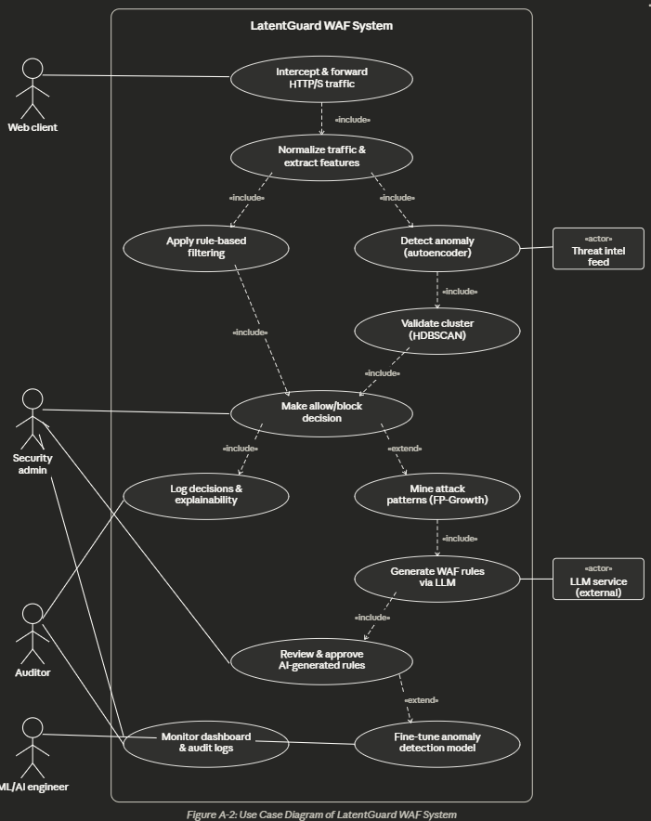
Use case diagram
Actors:
🔵 Web Client — initiates HTTP/S requests to the protected application
🔵 Security Admin — reviews AI-generated rules, monitors decisions & explainability logs
🔵 Auditor / ML Engineer — monitors dashboard, fine-tunes anomaly detection model
🔵 Threat Intel Feed / LLM Service — external actors feeding intelligence into the system
Key Use Cases:
Traffic interception → normalization → dual-layer detection (autoencoder + HDBSCAN)
Consensus engine makes final allow/block decision with full explainability
Attack patterns mined → LLM generates rules → human approval before deployment

Slide 9
Activity Diagram
Incoming HTTP requests are preprocessed and analyzed
ModSecurity + OWASP CRS detect known web attacks
Requests are classified into high, medium, or low risk
High-risk requests are blocked immediately
Low-risk requests are forwarded to the backend
Medium-risk requests are analyzed by AI models
Autoencoder and HDBSCAN generate anomaly score.
A consensus score determines the final decision
All requests and actions are logged into MongoDB

Slide 10
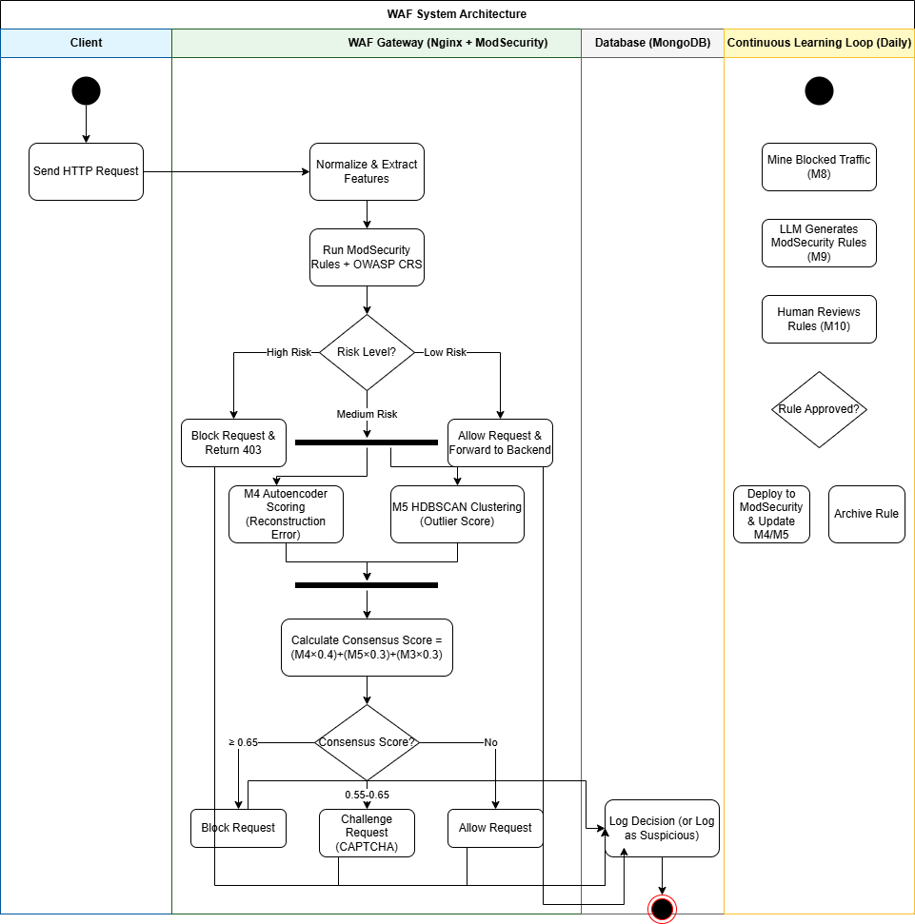

Slide 11
Design Models for Procedural Approach
Data Diagrams
Purpose: To show how data moves through the system, including requests, features, anomaly scores, and generated rules.
Level 0: Context Diagram
This is the simplest view — one circle for the system, surrounded by external entities that send data in or receive data out.
External entities:
Client — sends HTTP requests, receives block/allow responses
Admin — views dashboard, approves/rejects rules
Backend Application — receives allowed requests
LLM Service (OpenAI/Llama) — receives attack patterns, returns rules

Slide 12
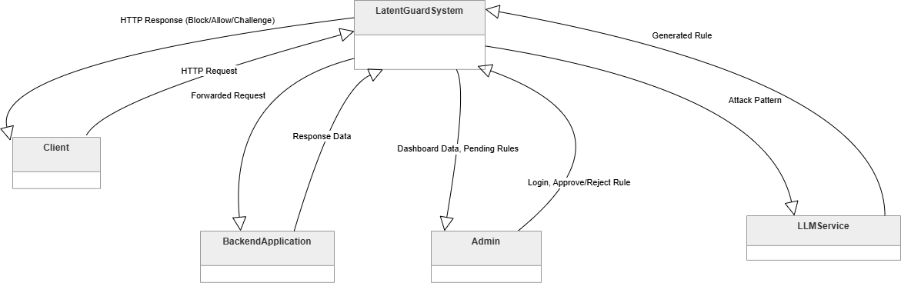
Level 0

Slide 13
DATA Diagram Level 1
Processes
1.0 Process Request – Normalizes request, extracts features
2.0 Detect Anomalies – Runs M4 and M5, produces scores
3.0 Make Decision – Consensus engine, block/allow
4.0 Log Data – Stores everything to MongoDB
5.0 Generate Rules – M8-M10 pipeline for continuous learning
Data Stores
D1: Rule Definitions (ModSecurity rules)
D2: Request Logs (MongoDB)
D3: Training Dataset (benign traffic)
Note: External entities from Level 0 are also shown here.

Slide 14
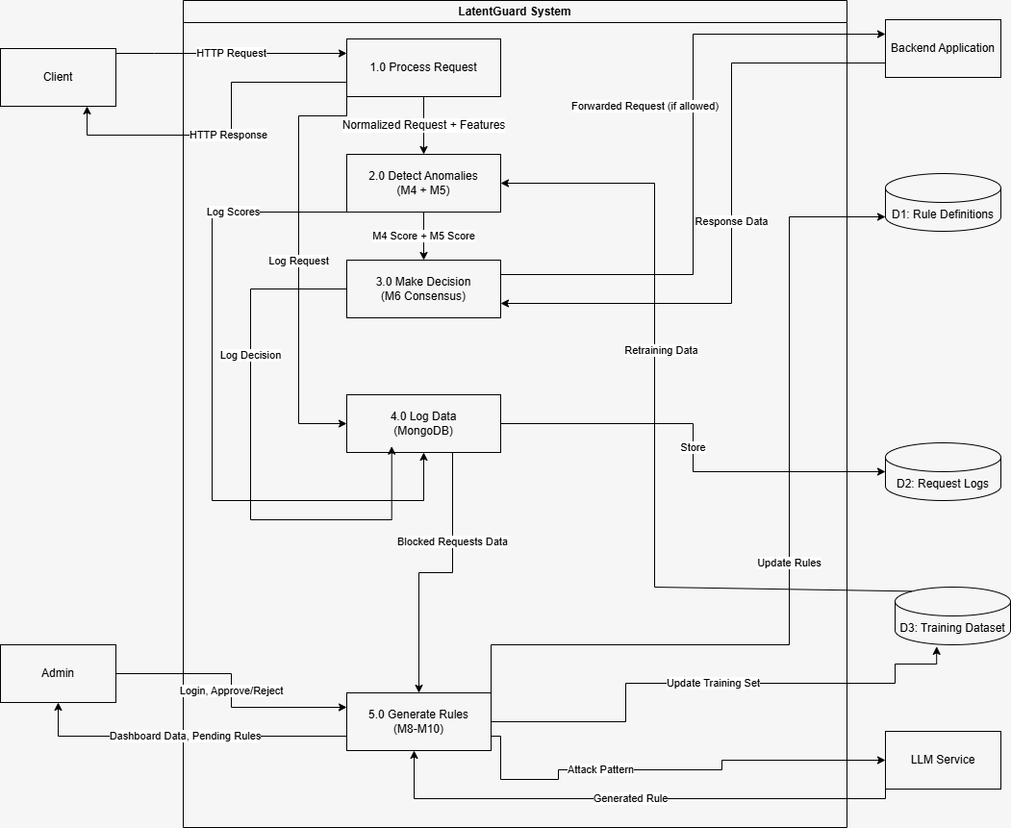

Slide 15
DATA Diagram Level 2
This is a deeper look at the AI detection process — the core of your project.
Sub-processes:
2.1: Run Autoencoder (M4) — takes feature vector, outputs reconstruction error
2.2: Run HDBSCAN (M5) — takes latent space, outputs outlier score
2.3: Aggregate Scores — collects both scores for consensus
Data flow:
Feature vector → 2.1 → anomaly score
Latent space (from autoencoder) → 2.2 → outlier score
Both scores → 2.3 → M4 and M5 scores ready for M6

Slide 16
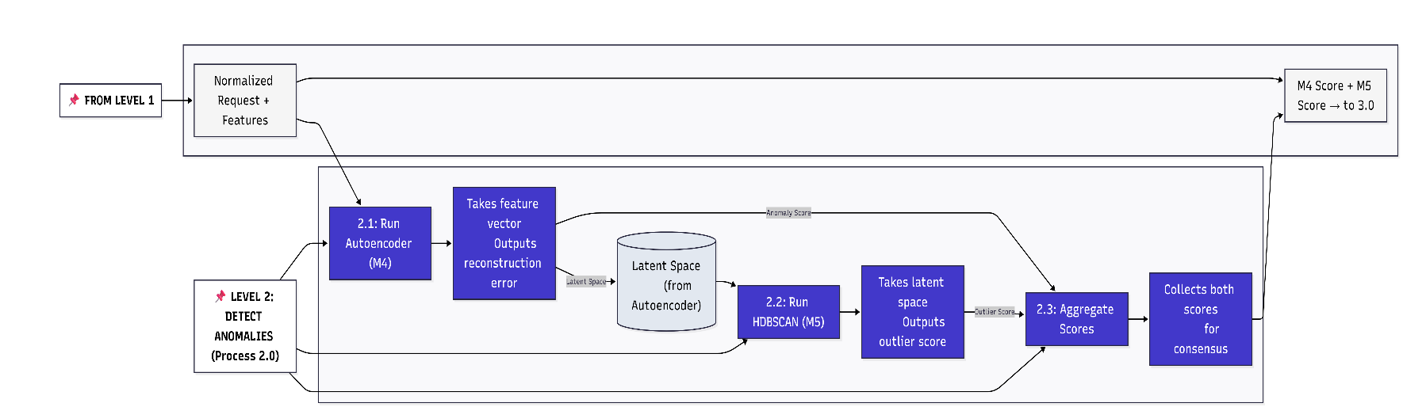

Slide 17
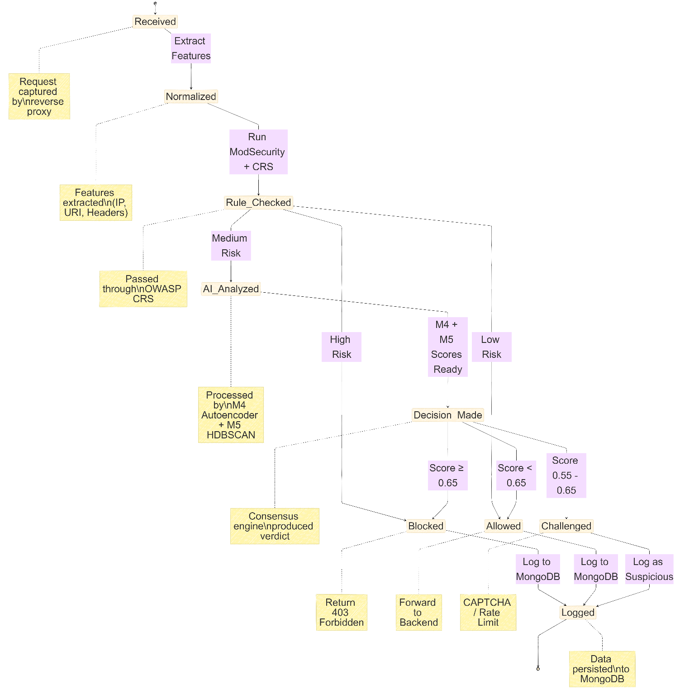
2) State Transition Diagram
The system combines signature-based detection with unsupervised machine learning techniques to improve detection accuracy.
The State Diagram is helping us visualize:
Trace the flow of requests from input to final decision
Visualize transitions between detection states
Understand how risk levels influence system behavior
Represent decision paths for allowed, challenged, or blocked requests
Simplify analysis of complex multi-stage security workflows

Slide 18
ERD (Entity Relationship Diagram)
The Entity Relationship Diagram (ERD) illustrates the data model of LatentGuard. The system stores five main entities: Request (raw HTTP requests), Decision (M4/M5/M3 scores and final verdict), Rule (AI-generated ModSecurity rules), AttackPattern (mined from blocked traffic), and TrainingSample (benign traffic for autoencoder training). A Request has one Decision. AttackPatterns generate Rules through the LLM pipeline. TrainingSamples feed the Autoencoder model for retraining. All data is stored in MongoDB collections. as a pipeline. A

Slide 19
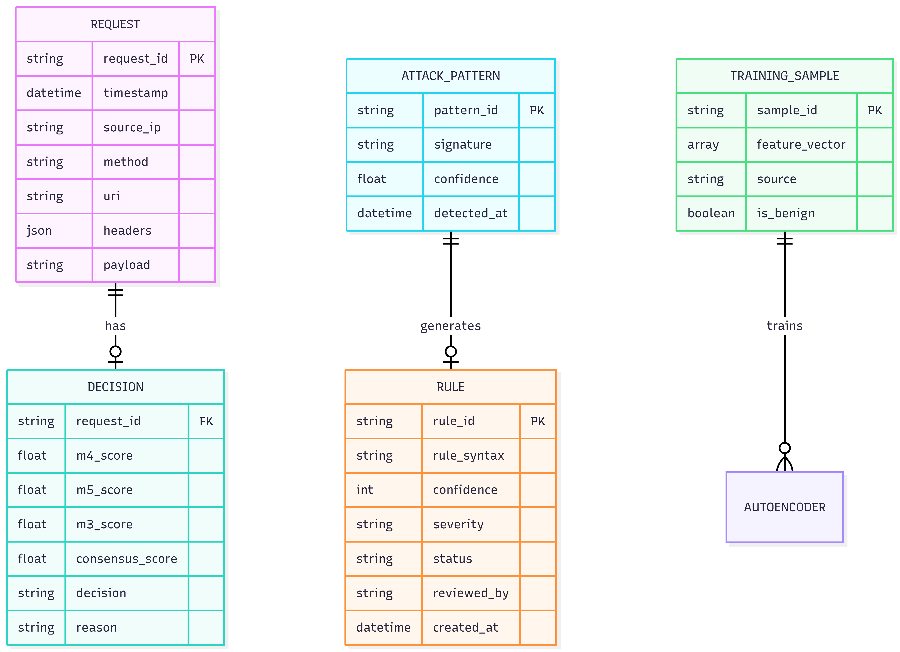

Slide 20
Implementation Slides
Phase | Completion | Modules
FYP-I (Current) | ✅ 30-35% | M1, M2, M3 ,M7, M10 (dashboard)
FYP-II (Planned) | ⏳ 70% | M4, M5, M6, M8, M9, M11, full ML pipeline

Slide 21
Modules We are Covering in FYP 1

Slide 22
Team Member Contributions
Team Member | Contribution
Member 1(Shaheer) | Go reverse proxy (M1), normalization & feature extraction (M2), MongoDB logging (M7)
Member 1(Shaheer) | ModSecurity/Coraza integration (M3), OWASP CRS setup
Member 2(Javaria) | React dashboard (M10), Chart.js graphs, API integration for metrics
Member 2(Javaria) | Docker orchestration, deployment, integration testing, documentation

Slide 23
Developed Modules & Key Algorithms Implemented Modules (FYP-I)
Module | Name | Status
M1 | Reverse Proxy (Nginx/Go) | ✅ Fully implemented
M2 | Normalization & Feature Extraction | ✅ Fully implemented
M3 | Rule Engine (ModSecurity + OWASP CRS) | ✅ Partial (core rules, no threat intel)
M7 | MongoDB Logger | ✅ Fully implemented
M10 | Admin Dashboard | ✅ Fully implemented

Slide 24

Data Design
MongoDB selected for schema flexibility. Collections designed to support auditing, model training datasets, and rule lifecycle management.
Major Collections
Retention Policy
request_logs: request_id, timestamp, source_ip, method, uri, headers, payload
decisions: request_id, m4_score, m5_score, m3_score, consensus_score, decision, reason
rules: rule_id, rule_syntax, confidence, severity, status, reviewed_by, created_at
training_dataset: sample_id, feature_vector (7 floats), source, is_benign
Detailed request logs: 90 days • Aggregated metrics: 365 days • Decisions: 365 days • Approved rules: Indefinite • False positive reports: 365 days
Schema Considerations
Document versioning for evolving features, anonymization for privacy, and indexes on request_id, source_ip, and timestamps for fast queries.

Slide 25



Implementation Status & Components
Completion: ~30–40% (FYP‑I). Implemented modules: M1 (Nginx proxy), M2 (Normalizer), M3 (ModSecurity integration — partial), M7 (MongoDB logging), M10 (React dashboard). Remaining modules deferred to FYP‑II.
Implemented — M1 / M2
Implemented — M7 / M10
Implemented — M3 (partial)
Go-based reverse proxy with TLS termination; normalization extracts 7 numeric features (length, entropy, token_count, special_char_ratio, digit_ratio, uppercase_ratio, is_post).
Atomic MongoDB logging and React dashboard for filtering, rule review, and basic metrics (requests, blocked rate).
OWASP CRS v4.7.0 integrated; HIGH/CRITICAL matches generate immediate BLOCK + reason.
Planned integrations for FYP‑II: TensorFlow autoencoder training, HDBSCAN clustering, consensus engine, FP‑Growth miner, LLM rule generation (OpenAI / Llama 2), and continuous learning pipeline.

Slide 26
Key Algorithm: Feature Extraction (M2)
Input: Raw HTTP Request (method, URI, headers, body)
Process:
1. URL-decode URI and body
2. Calculate 7 numeric features:
- Length - Shannon Entropy
- Token count - Special character ratio
- Digit ratio - Uppercase ratio
- is_post (boolean)
Output: Structured request + 7-float feature vector

Slide 27
Key Algorithm: Rule Enforcement (M3)
text
Input: Normalized request, OWASP CRS ruleset
Process:
For each rule in ruleset:
If rule matches request:
If severity is "CRITICAL" or "HIGH":
Return BLOCK + rule_id + reason
Return ALLOW (no rules matched)

Slide 28
Planned for FYP-II
API / Library | Purpose
TensorFlow / Keras | Autoencoder training and inference
HDBSCAN (Python) | Clustering for outlier detection
OpenAI API / Llama 2 | LLM-assisted rule generation
FastAPI | ML service endpoints

Slide 29
DEMO………

Slide 30

Testing Strategy & Results
Multi‑layered testing approach: unit, functional, business‑rules, and integration testing. Emphasis on black‑box for functional and white‑box for unit tests.
Unit Tests
M1, M2, M3, M7 — verify logic in isolation (e.g., SQLi input → M3 BLOCK + rule ID).
Functional & Integration
End‑to‑end pipeline tests and dashboard performance (dashboard load <2s). 100 mixed requests maintained 100% consistency between logs and dashboard metrics.
Business Rules Testing
Decision tables ensure severity mapping to BLOCK/ALLOW logic; fallback behavior tested when MongoDB is unavailable (in‑memory buffer validated).
Summary: 40 test cases executed — 40 passed (100% pass rate) across unit, functional, business‑rules, and integration categories for implemented modules.

Slide 31
Slide 9: Testing Slides
Test Type | Used? | Justification
Unit Testing | ✅ Yes | Test individual functions (feature extraction, rule matching, logging) in isolation
Integration Testing | ✅ Yes | Verify M1+M2+M3+M7 work together end-to-end
Functional Testing | ✅ Yes | Test user-facing features (dashboard, API responses)
Black Box Testing | ✅ Yes | Test WAF behavior without knowing internal implementation (send attacks, check responses)
White Box Testing | ✅ Yes | Unit tests examine internal functions (feature extraction logic)
System Testing | ⏳ Planned | Full system test in FYP-II after AI modules added

Slide 32
Test Cases (FYP-I)
Modules Tested
Module | Tests Conducted
M2 (Normalizer) | 4 unit tests (normal GET, POST, URL decode, empty request)
M3 (Rule Engine) | 4 unit tests (SQLi, XSS, path traversal, normal request)
M7 (Logger) | 4 unit tests (insert, verify reasons, duplicate, connection failure)
M1 (Proxy) | 4 unit tests (forward, block, HTTPS, backend unavailable)
End-to-End Pipeline | 3 integration tests (normal flow, malicious flow, data consistency)

Slide 33
Test Case | Input | Expected | Actual | Status
SQL Injection | GET /page?id=1' OR '1'='1 | BLOCK (403) | BLOCK (403) | ✅ Pass
XSS Attack | GET /search?q=<script> | BLOCK (403) | BLOCK (403) | ✅ Pass
Path Traversal | GET /../../etc/passwd | BLOCK (403) | BLOCK (403) | ✅ Pass
Normal Request | GET /index.html | ALLOW (200) | ALLOW (200) | ✅ Pass
Sample Test Results

Slide 34

Conclusion & Next Steps
Key design choices: layered pipeline, dual AI detectors (Autoencoder + HDBSCAN) combined with ModSecurity, weighted consensus (M4 40% / M5 30% / M3 30%), and human‑in‑the‑loop LLM rule generation to prevent unsafe rules in production.
1
2
3
FYP‑II Priorities
Advanced Research
Operational Enhancements
Implement & train M4/M5 with CSIC 2010 / CICIDS 2017 datasets; deploy consensus engine and continuous learning loop.
Explore VAEs, transformer‑based HTTP analyzers, SHAP explainability, federated learning, and multi‑protocol support (WebSocket, gRPC, GraphQL).
Real‑time rule deployment without restarts, multi‑tenancy, compliance reporting (PCI‑DSS, HIPAA, GDPR), and production hardening (secrets management, network policies).
Recommended immediate actions: finalize M4/M5 prototypes offline using anonymized logs, define evaluation metrics (TPR/FPR, precision/recall), and implement CI pipelines for model retraining and safe rule rollout.

Slide 35
THANK YOU!

